Slide 1
Spatial Analysis for Beginners
Christian Lopez-Farnes
Monday, June 8, 2020
Notes:
All headlines on slides should be ARIAL BLACK, ALL CAPS
All supporting fonts should be Times

Slide 2
Age-nda
Upcoming Trainings
Workflow Background
Designer Training
Support

Slide 3

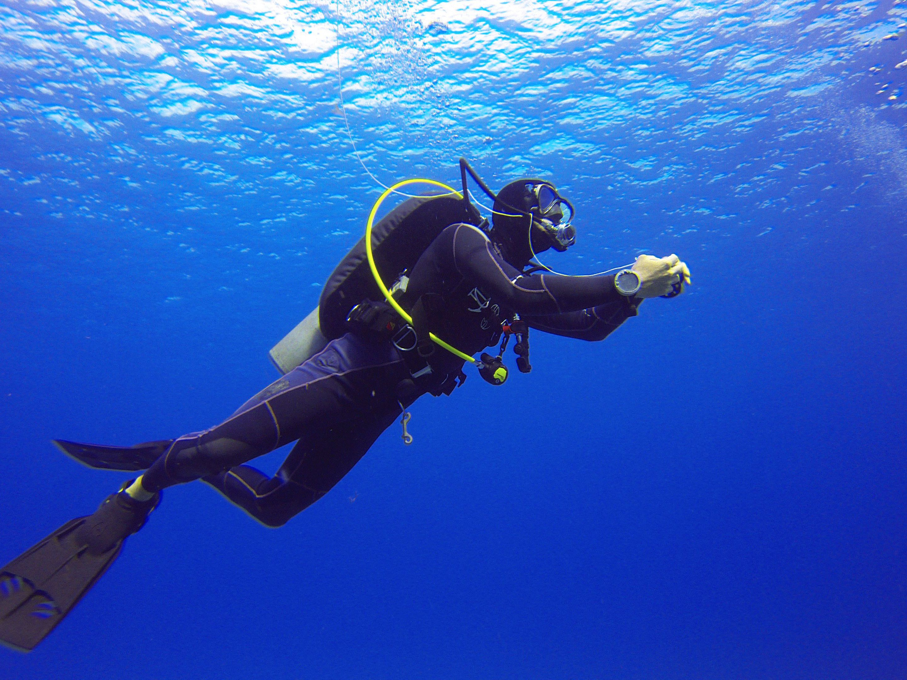

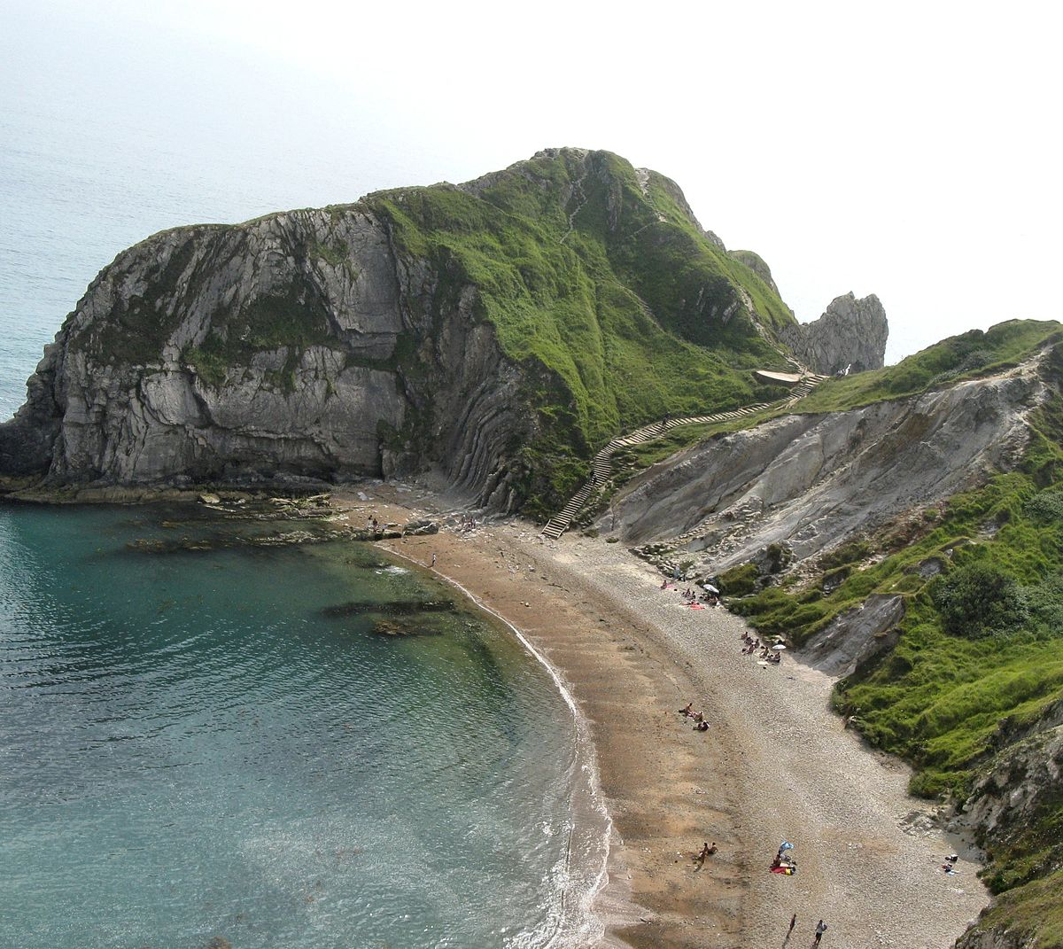

With Alteryx, I can do anything
Christian
lopez
ALTERYX USER SINCE 2019
Scuba Diving
Sj Sharks fan
Love to travel
Love Software
When I use Alteryx, I feel like I can do anything faster.

Slide 4

COMMUNITY.ALTERYX.COM
Find answers quickly
Share your knowledge
Connect with peers
Discover new Alteryx use cases
Submit your bright ideas
Read insightful blogs
Develop tools, macros, and apps

Slide 5

Knowledge is power
Alteryx academy
Interactive Lessons
Live Training
Weekly Challenges
Product Certification
ACADEMY.ALTERYX.COM

Slide 6
Upcoming live trainings
Tuesday – Intro to reporting
Wednesday – Parsing with RegEx
Thursday – Predictive Analysis
Friday – Macros

Slide 7
Workflow background

Slide 8
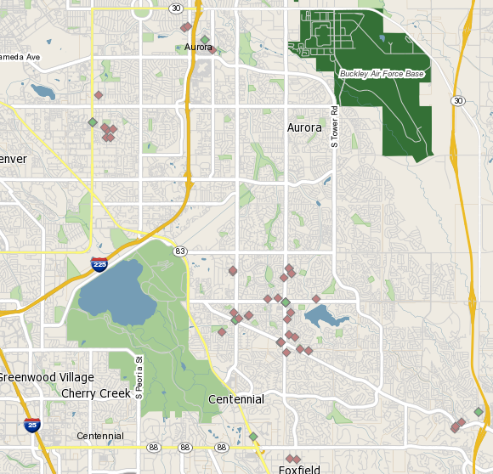
Use case
Issue:
Measuring customer distance to a store location in both drive mileage and drive time can be time intensive
Other solutions require custom coding
Goals:
Find customers within 2.5 minutes if any given store
Find customers (if more than 2.5 min away), within a mile walk

Slide 9
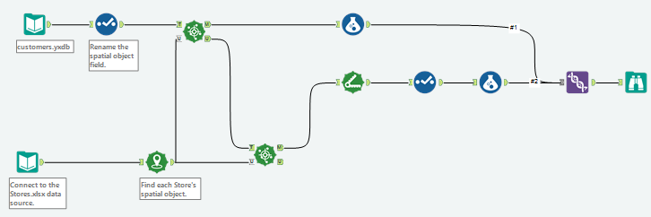






Key concepts
Processes covered
Generating spatial points
Measuring distance between locations
Tools covered
Create Points
Find Nearest
Formula
Union
Input data
Distance
Notes:
If you insert a table in PPT, it defaults fonts to Arial; Arial is not part of our brand. If you insert a table on the right, please reference slide 22 in this PPT to see how to apply fonts to Tables

Slide 10
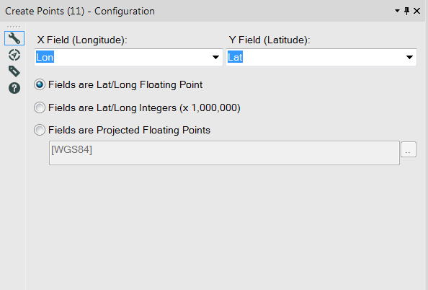
Create point tool
Convert lon/lat fields into a spatial object point
Choose what format the lon/lat appear in:
Floating point (most common)
-105.24611 , 40.036617
Integers
-10524611 , 40036617
Projected floating points
-11715954.616441, 4843772.952452

Slide 11
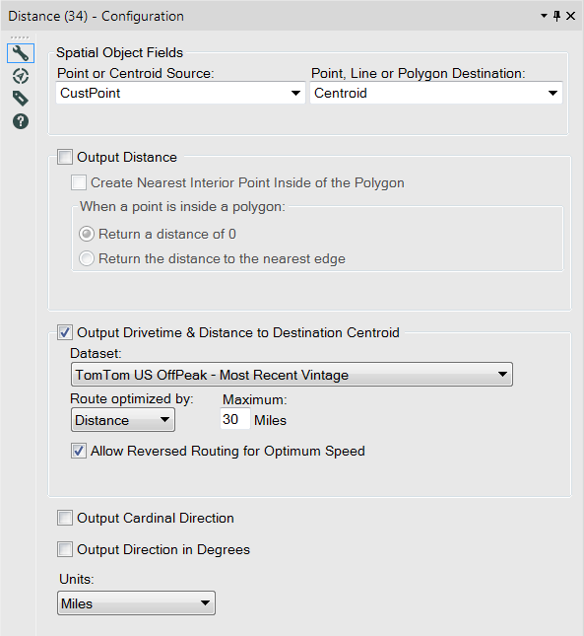
Distance tool
Choose two points to calculate a distance
Output radial distance
Output drive distance and drive time
Reverse routing available if there are fewer destination points than source points
Output direction from source to destinations
Cardinal direction
Direction in degrees
Set units of distance

Slide 12
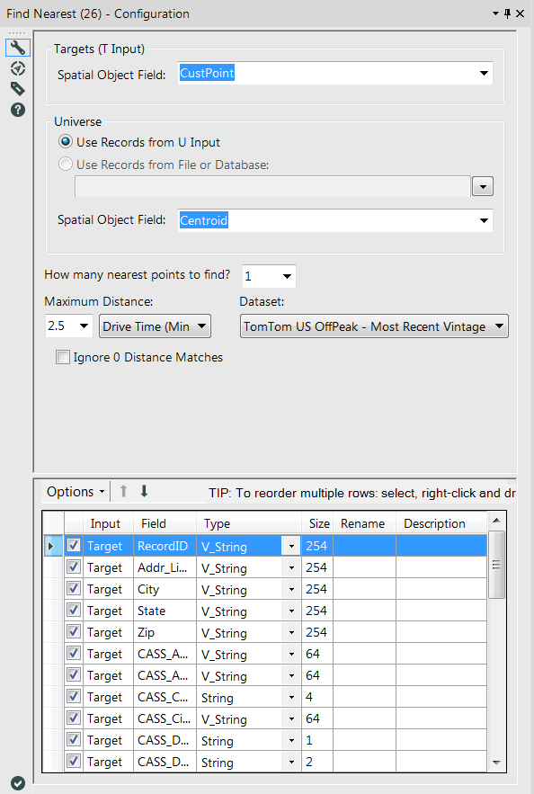
Find nearest tool
Target
Analysis on point or centroid
Universe
Dataset to match to the target field
Specify how many universe objects to match to a target value
Choose different methods
Radial distance (Miles, KMs)
Drive Distance (Miles, KMs)
Drive Time

Slide 13
Alteryx designer training

Slide 14
support

Slide 15
SUPPORT RESOURCES
1
ALTERYX COMMUNITY
2
ALTERYX ACADEMY
3
TECHNICAL SUPPORT
Post your questions, search discussion forums, read Knowledge Base articles and contribute your knowledge at community.alteryx.com.
Register for Live Training sessions, complete interactive lessons, participate in the Weekly Challenge and learn about product certification at academy.alteryx.com.
Email: support@alteryx.com
Notes:
If you need to adjust the placement of the boxes or the text within the shapes, make sure you are left justifying or right justifying, NOT centering

Slide 16
See what Alteryx can do for you!
Download a free trial of Alteryx alteryx.com/trial

